Slide 1
INTRODUCTION TO API Development for ArchivesSpace
May 5, 2023 • Northwest Archivists Annual Meeting • Salem, Oregon
Austin Munsell and Alexa Goff • University of Oregon Libraries
MINI-WORKSHOP PART 1
Notes:
Austin Munsell, Collections Manager at University of Oregon Special Collections and University Archives
My colleague and co-presenter is Alexa Goff, Accessioning and Processing Archivist

Slide 2
Welcome!
Notes:
Thanks to Alexa for setting up a little poll to kick things off.
-Alexa and I do not come from programming backgrounds. We both work primarily with our physical archival collections, skills and tools developed around API programming are all learned on the job from solving our own problems…Practitioners solving our own problems with programming and learning as we go.

Slide 3
“Have you tried the API?”
Notes:
I want to take a few moments to talk about the title of this session. Early on in my archival career I started looking for technology tools scaled to some of the larger tasks I faced. Question or variation on it seen on listservs and in documentation
Frustrating phrase – pointing to GitHUb repositiories full of code I didn’t understand or know how to begin using.
-programmer at UO introduced me to Postman, and I started tinkering with very basic manipulation of our data through the API, much in the same way I will talk about shortly and Alexa will demonstrate later.
-on-ramp That is what we are trying to bring with this session: You give us a couple hours, and we will try to move the needle on your answer to this question, even if the answer is yes, and I hate it.

Slide 4
OVERVIEW
What is an API?
What is the ArchivesSpace API?
What can you do with the ArchivesSpace API?
Examples from the University of Oregon
Introduction to using Postman & Demonstration
Resources
PART 1
PART 2
Guided Hands-on Demonstration for Beginners
Notes:
We have a pretty full agenda for these two session. We are going to cover what I think is a lot of material in this session, and while we hope to have time for questions at the end, I would encourage any of you to reach out later or just corner Alexa or I if you see something you’d like to discuss more.
First I am going to go through my non-programmers understanding of what an API is and what the ArchivesSpace API is specifically, followed by a few examples of varying complexity of API projects and tools we've developed at UO.
Then, Alexa is going to introduce you to Postman, the API development platform that has become our go to tool at UO. A note about Postman: we are using it because it is what we are used to, there are many other tools out there, though Postman is kind of the big fish now, but there are caps on things you can do with free account and other things you will want to make yourself aware of if you start using it.
Then we will come back at 10:30 with whomever wants to actually try poking your own ArchivesSpace instance via the API (note, you will need to know the url for it and you might need VPN).

Slide 5
WHAT IS AN API?

Slide 6
WHAT IS AN API?
API Land
This
That
An intermediary that allows two applications to talk.
Notes:
API: Application Programming Interface
-A human, me, tells my application, this, to interact with something out there in the wild, that.
-A specific vocabulary, called endpoints in API terminology, set by That out in the wild, through which these two applications can communicate.

Slide 7
WHAT IS THE ARCHIVESSPACE API?

Slide 8
WHAT IS THE ARCHIVESSPACE API?
Computer
ArchivesSpace
Notes:
ArchivesSpace has a set of vocabulary to communicate with it’s back end.
Called API endpoints, these are really just ways of communicating about specific types of records, like resources, agents, subjects, locations… basically anything you can interact with in the ArchivesSpace staff interface. In fact, every time you change something in the staff interface you are actually using an API, it just has a friendly skin on it.

Slide 9
WHAT IS THE ARCHIVESSPACE API?
☺ = Good
Authentication
Computer
ArchivesSpace
Session
Notes:
Interacting with ArchivesSpace records through the API is really a two step process, but it is very similar to working with the staff interface. First, ArchivesSpace wants to know that you are allowed to do whatever it is your are doing (just like logging in to the staff interface). So, authenticate by telling it who you are, and then in passes you back a session, also known as a window of time to do the junk you want to do.

Slide 10
WHAT IS THE ARCHIVESSPACE API?
Ursula Le Guin papers
☺ = Good
GET:https://archives.uoregon.edu/api/repositories/2/resources/8689
Computer
ArchivesSpace
Notes:
-I want X – API call just looks like a url
I’m going to walk through an example where I want to get a resource record and then change it, which is also what Alexa will be doing with Postman later.
-GET is just telling the API what I want to do. I want it to get me this record. The ArchivesSpace API only has three commands, GET, POST and DELETE. Get is for retrieving a record, and we’ll get into Post in a second. Delete is pretty self explanatory, it deletes records.
-The Green part is the base of the API, and this will be institution specific. This is going to be part of any API call working with my ArchivesSpace.
The second part says Ursula le Guin papers record in Aspace API vocabulary. Let’s take a second to parse where that is coming from.

Slide 11
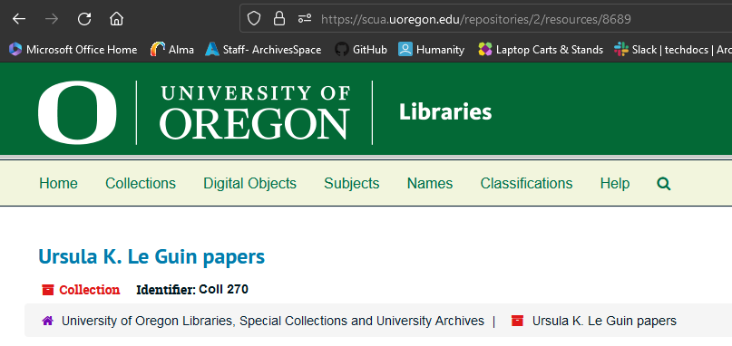
WHAT IS THE ARCHIVESSPACE API?
Ursula Le Guin papers
☺ = Good
GET:https://archives.uoregon.edu/api/repositories/2/resources/8689
Computer
ArchivesSpace
Notes:
And where is that coming from? If you look up any record in Aspace, you will see a number at the end of it. This is the record ID, and this is what the ArchivesSpace API wants if it is going to run. The act of getting those ids can be one of the first barriers to working with the API once you’ve set a session. As you are just starting out, just looking in the staff interface and getting that number can be a good way to quickly grab an ID to test things. I’ll show you a method a little further on for building a directory of all of them.

Slide 12
WHAT IS THE ARCHIVESSPACE API?
☺
☺ = Good
Computer
ArchivesSpace
{
"lock_version": 104,
"title": "Ursula K. Le Guin papers",
"publish": true,
"restrictions": false,
"ead_id": "ORU_Coll270.xml",
…..
Notes:
And then, what comes back is all the data for that record in something called JSON. Just a machine readable view of all that data in the record. This is just the very top of the record, obviously it is much larger than this, but this is what is passed back. So, great, but then what?

Slide 13
WHAT IS THE ARCHIVESSPACE API?
Change it!
☺ = Good
POST:https://archives.uoregon.edu/api/repositories/2/resources/8689
Computer
ArchivesSpace
{
"lock_version": 104,
"title": “SOMETHING ELSE",
"publish": true,
"restrictions": false,
"ead_id": "ORU_Coll270.xml",
…..
Notes:
Well, now that I have that record I can change it, and pass it back to the API using POST,
Post has two meanings: it can either mean create something new or update something that already exists. And the meaning is comes from what you are trying to pass in and whether it already exists or not. If I were trying to give this to ArchivesSpace as a new record, I wouldn’t add the slash 8689 at the end and ArchivesSpace would know we are trying to create something new. But we have that unique ID number, so it knows we mean Ursula Le Guin Papers in UO ArchivesSpace speak, and that I want to change the title to the words something else in all caps.
You can picture that as one circuit, but we are talking about computers, so they can run these loops all day. So, let’s say that instead of passing the ID for Ursula le guin, I pass it all the ids for every collection in our repository as a spreadsheet. Well, then I can change every title to “Something Else” in one fell swoop. So now we’re getting somewhere.

Slide 14
WHAT IS THE ARCHIVESSPACE API?
☺
☺ = Good
Computer
ArchivesSpace
Updated
Notes:
And then, once we've completed that circuit, ArchivesSpace will pass me back a message that the record was updated, again just like if I was using the staff interface.
You can picture that as one circuit, but we are talking about computers, so they can run these loops all day. So, let’s say that instead of passing the ID for Ursula le guin, I pass it all the ids for every collection in our repository as a spreadsheet. Well, then I can change every title to “Something Else” in one fell swoop. So now we’re getting somewhere.
Bricks and houses/buildings

Slide 15
WHAT CAN YOU DO WITH THE ARCHIVESSPACE API?

Slide 16
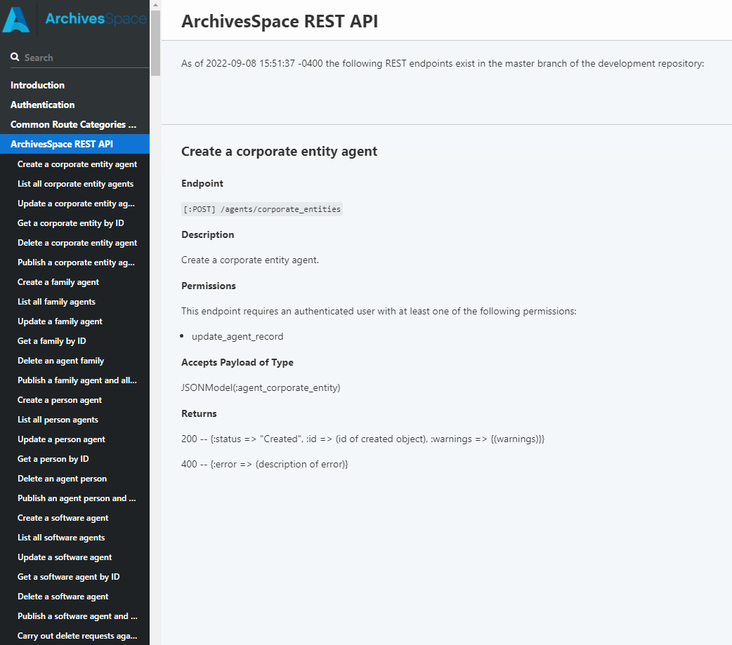
WHAT CAN YOU DO WITH THE ARCHIVESSPACE API?
Custom reports (GET)
Create or Update ArchivesSpace things (POST)
Based on spreadsheets
Based on standardized data
Based on other records (if they can also be accessed via API)
Delete ArchivesSpace things (DELETE)
🔗archivesspace.github.io/archivesspace/api
Notes:
The API is a champ when handling any simple, repeated task. Something with a starting point and an end point. I have all of these records, and I want to create them or change them in some way.
If you want to build a tool that takes spreadsheets and turns them into records, this is how you do it. I’m sure many of you are familiar with the Harvard Importer. The same post something strategy in my diagram is exactly how that thing runs.

Slide 17
EXAMPLES FROM THE UNIVERSITY OF OREGON
Notes:
5 examples of varying complexity. 5 small to midsize houses we built.

Slide 18
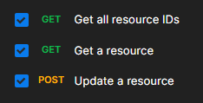
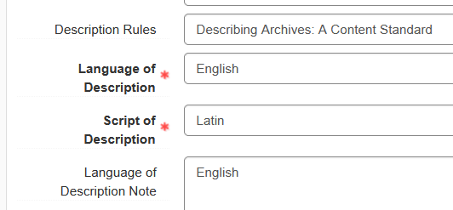
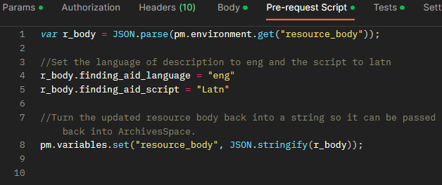
EXAMPLES: UPDATING LANGUAGE AND DESCRIPTION ACROSS ALL COLLECTIONS
Notes:
-A loop that I built to run over all our resource records after Language and Script of description became required fields.
-Learned the bits of javascript code used to update things mainly through Google.
-Got everything and ping pongs back and forth updating the specific fields in each record.
-If I built it today, I would probably put in something that checks for existing language and description and doesn’t overwrite those, just in case there was an FA with another language listed

Slide 19
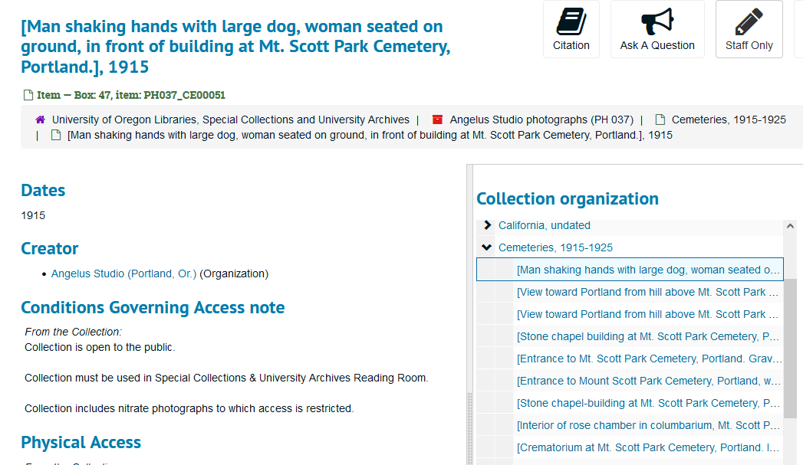
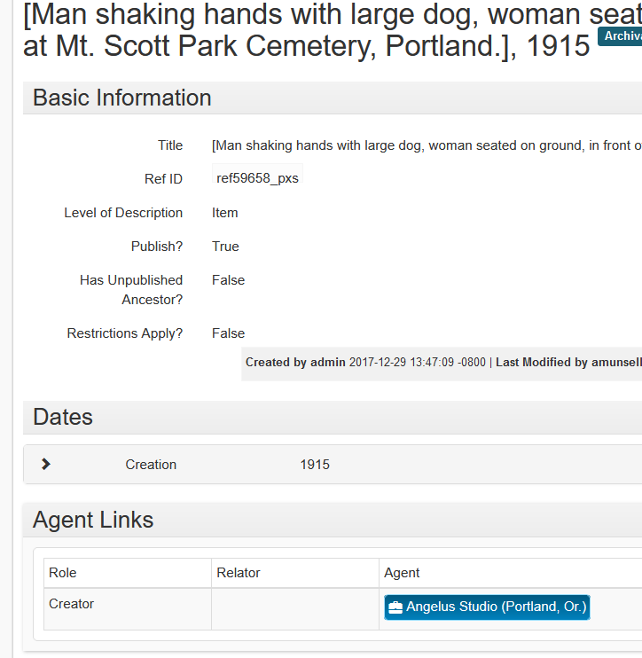
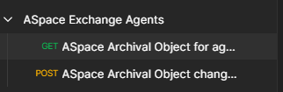
EXAMPLES: EXCHANGE BAD AGENT RECORD FOR GOOD ACROSS 12,000 OBJECTS
Notes:
This is a good one off API project example.
We have a massive FA for the Angelus studio photographs with over 12,000 archival object describing photos at the item level. Photographers are listed at the item level as well since this collection actually represents the work of a number of different photographers. Somewhere along the line, a good happened and two version of the agent record for the studio were created, one that was a person and one that was a corporate body. Description happened and these were used here and there throughout these 12,000 objects. Can’t merge a corporate body and an person. To fix, I worked with Liliya Benz in our processing unit to come up with an API tool that would look for the wrong agent record across the entire FA and replace it with the right one. Then at the end she deleted the person agent.
I sincerely hope we never need to use this tool again

Slide 20
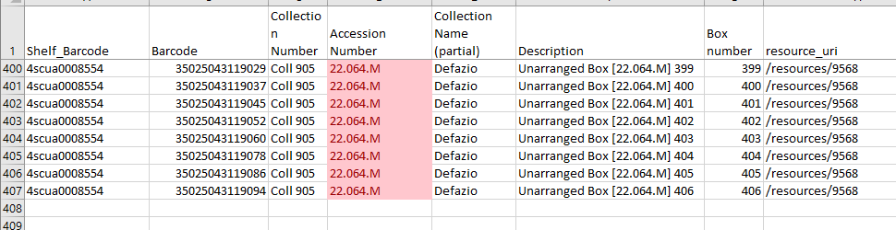
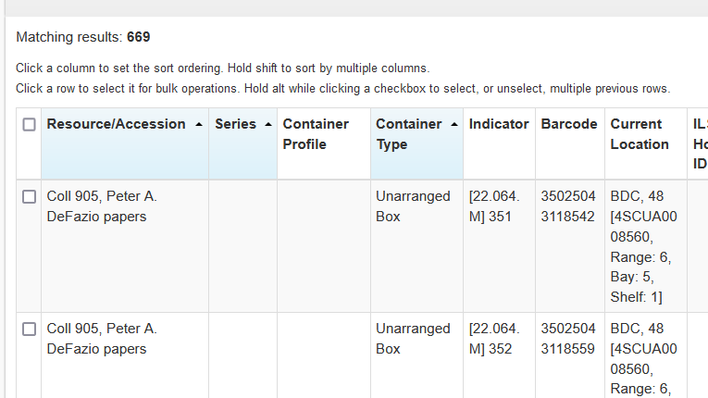
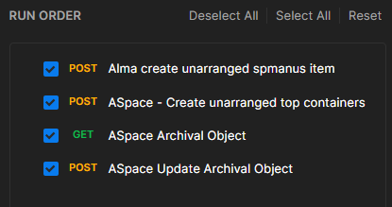
EXAMPLES: ADDING INVENTORY AND INSTANCES TO A COLLECTION
Notes:
-Retirement of a congressperson with a long standing agreement to donate papers to your institution results in 700 boxes to receive and track.
-Add the inventory to both ArchivesSpace and Alma, because we use the library catalog to track physical movement of items. Also adds the physical location of each box, which we barcode. All told, we had the material off the trucks, on the shelves and tracked within two days, which was a nice thing to be able to send back to the donor so they could see that we were taking care of things.

Slide 21
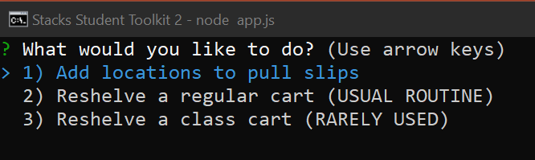
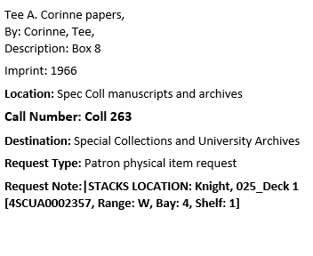
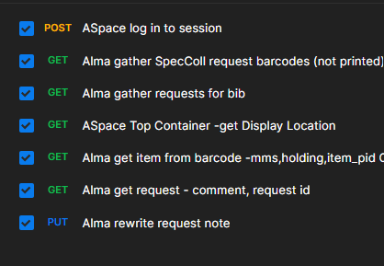
EXAMPLES: THE STACKS STUDENT TOOLKIT
Notes:
This is actually the tool that got me started working with the APIs generally back in 2018. In the good old days, when patrons requested an item staff would look up the location where it was stored and had write that information on our pull slips. This was actually what started me looking at APIs, because it felt foolish that this location information which was on the computer had to be translated by a human into this other system that created paging slips, which was also on the computer. This communicates with that is API country, so, cutting out a lot of middle steps, I built a thing where student workers click an Add locations to pull slips box, and then APIs go out and grab all the requests and all the locations and poop them right into the pull slips that we print before we do it. This saved a lot of time and greatly reduced the number of errors because the API tends not to make transcription errors. If something is wrong, it is usually that we haven’t tracked something well.

Slide 22
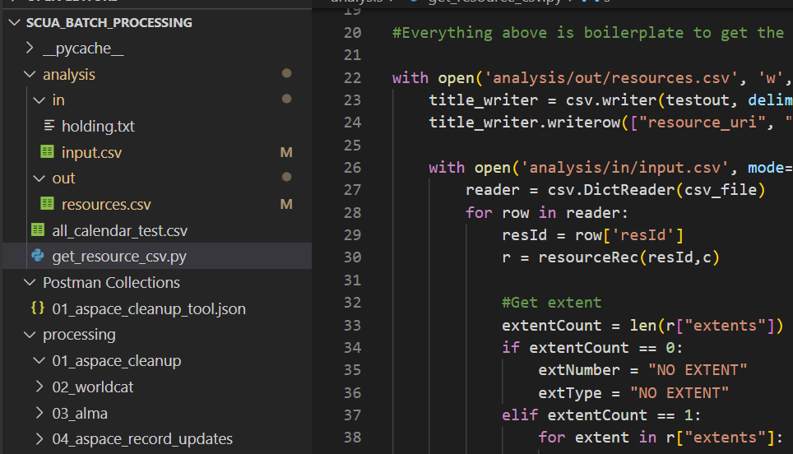
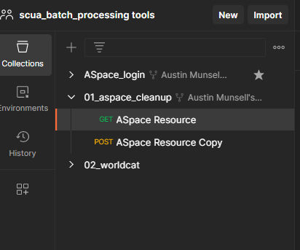
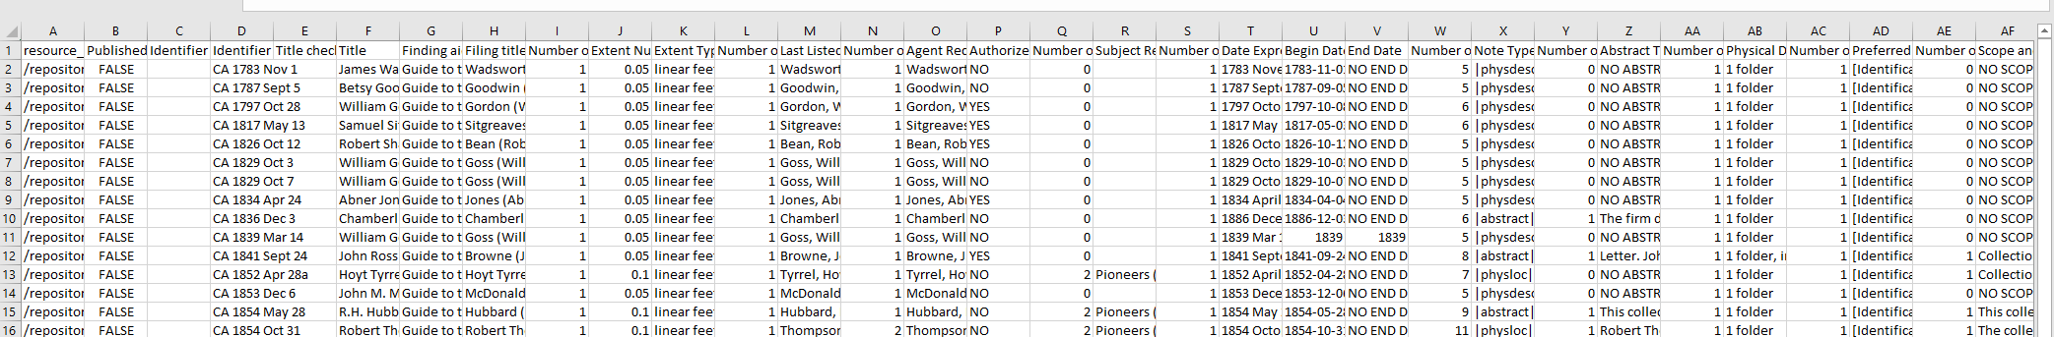
EXAMPLES: BATCH LEGACY RECORD PROCESSING WORKFLOW (A WORK IN PROGRESS)
Notes:
This is a next step project I’ve been working on to help us make more of our small collections that have never been published out available without a lot of physical processing work. It is also my first steps into learning to use Python to work with the API, which has actually been pretty rewarding and is really helped by all the work I’ve done in tools like Postman. Since I understand the basic structure of how API tools should work, it is more about figuring out how to map that to Python instead of
Reach out to ArchivesSpace and create a monster of a spreadsheet that includes all fields required for minimum published description if something is going to be made available. Then, use that spreadsheet as a tool to add missing required fields back in so we can publish the record, update or create all the other records like Archives West and Worldcat, and then call it a day on these collections. I’m working on two test batches right now: one of 33 photo albums that were reviewed by our pictorial curator and one of 77 single folder, often single leaf pioneer letters and documents that were never published. Work in progress but the initial results are promising.

Slide 23

INTRODUCTION TO USING POSTMAN

Slide 24
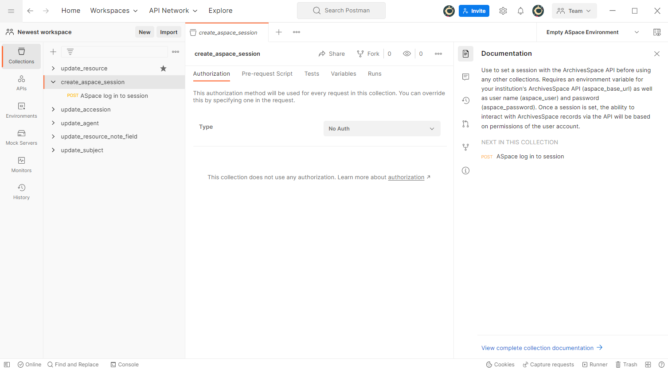
POSTMAN: USER INTERFACE
Notes:
Here is the

Slide 25
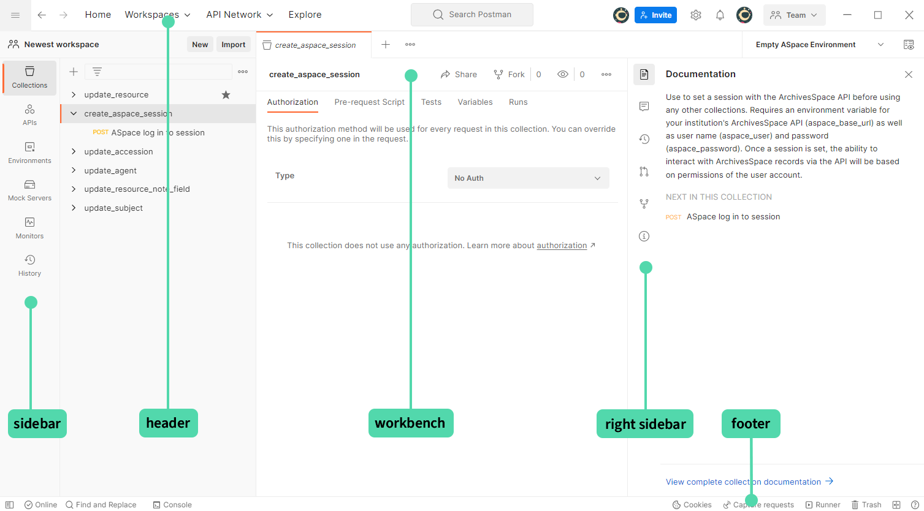
POSTMAN: USER INTERFACE

Slide 26
POSTMAN: USER INTERFACE

Slide 27
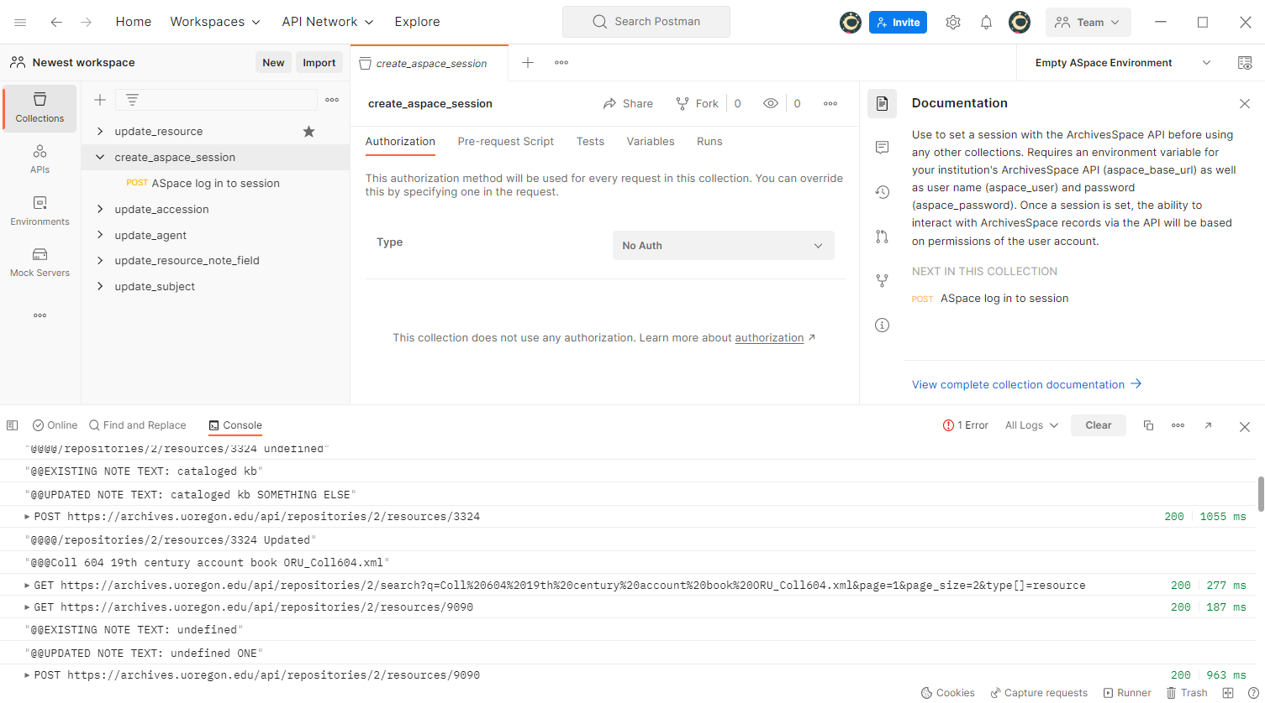
POSTMAN: CONSOLE

Slide 28
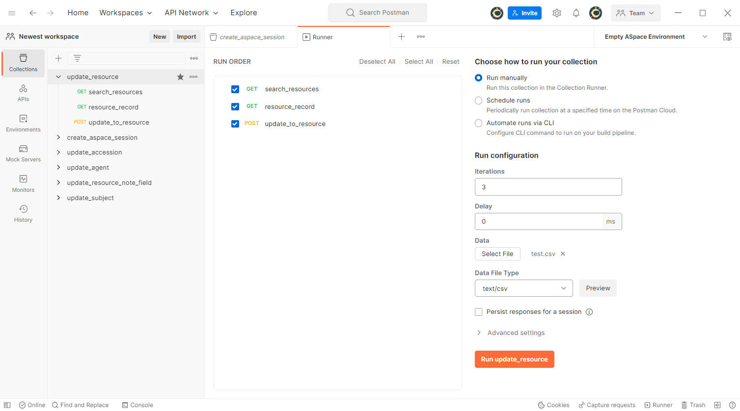
POSTMAN: COLLECTION RUNNER

Slide 29
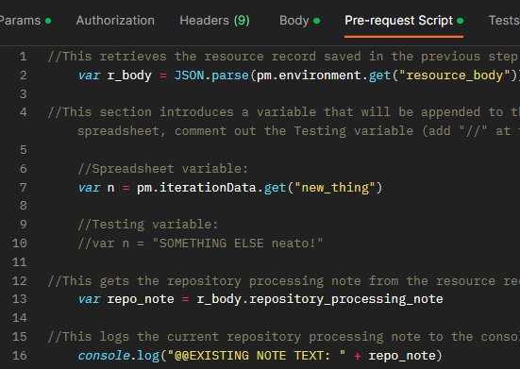
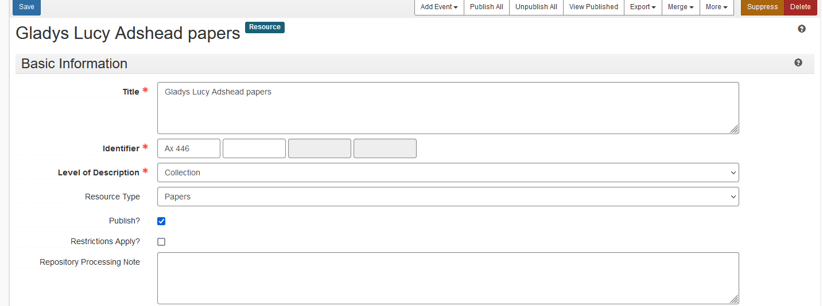
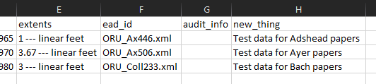
POSTMAN: SWITCH TO LIVE DEMO

Slide 30
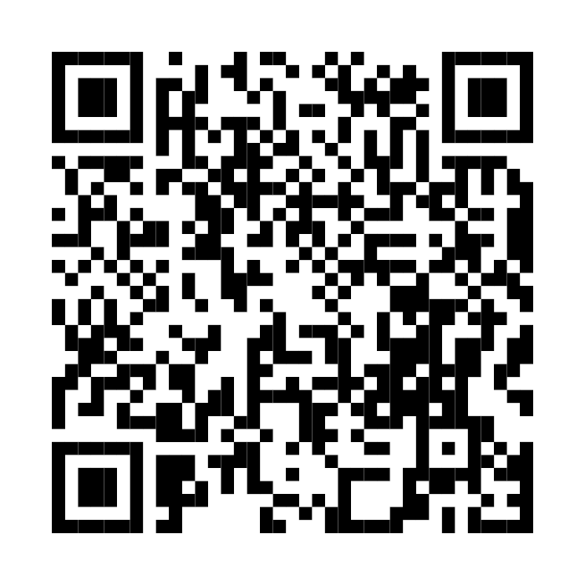
Materials from this session available at our
GitHub repository
🔗 bit.ly/nwa-api

Slide 31
INTRODUCTION TO API Development for ArchivesSpace
May 5, 2023 • Northwest Archivists Annual Meeting • Salem, Oregon
Austin Munsell and Alexa Goff • University of Oregon Libraries
MINI-WORKSHOP PART 2
Notes:
Things for Austin to note introducing:
Recap for those who were not at part 1: We at UO have had good success working with the ArchivesSpace API to streamline workflows and deal with otherwise very time consuming projects like massive data updates, ingesting of various records and getting ASpace data to talk to and populate other systems.
The goal of this section is to get participants who wish to join us through what amounts to a few months of tinkering as we were first figuring out how to use Postman, an API development platform, to do some basic record manipulation. If you come out of this hour with a reasonable sense of how this tool works, you'll have reached a point it took me a few months to get to as I was first figuring things out. What we are going to actually do is pretty trivial, updating a repository processing note, and that is intentional because a) we didn't want to mess with anything too important and this field does not publish b) this is a field that is in every resource record. However, the tool we are going to work with, and anything else we've shared, can easily be copied and repurposed for something else. We also aren't going to get into error handling and debugging in this short of a session, but things may come up organically.
Working live on a web interfacing tool with this many people may cause problems. There are also many other ways things might go wrong. We also may not get through the entire demo depending on how things go, and we will stop at 11:25 at the latest so there is time to wrap up, but the github repo has all the documentation and we created slides for the entire demonstration as a backup.
Hand signals: thumbs up for things are working, hand up for I need help.
We will also pause briefly for questions in a few places as we go.

Slide 32
Requirements to participate in Part 2:
Laptop
Connected to Wi-Fi
Institutional VPN (may not be required)
Institutional ArchivesSpace API URL
Institutional ArchivesSpace user credentials (sign-in now)
Postman application installed with user credentials (sign-in now)
Ready? Go to: bit.ly/nwa-api

Slide 33
PART 1: GETTING SET UP

Slide 34
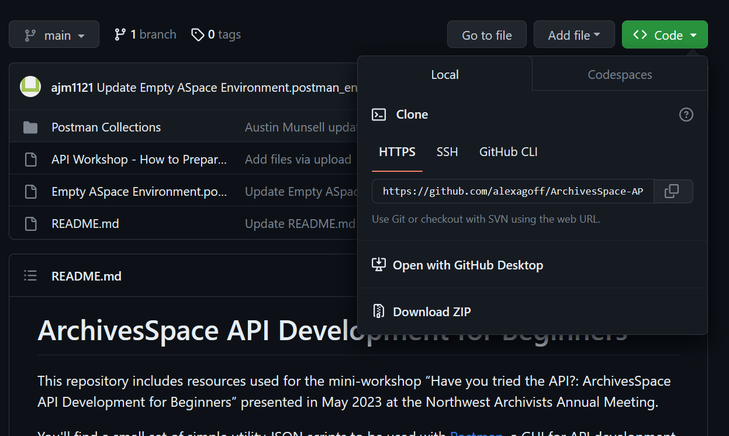
SETTING UP: DOWNLOAD AND UNZIP THE GITHUB FILES
bit.ly/nwa-api

Slide 35
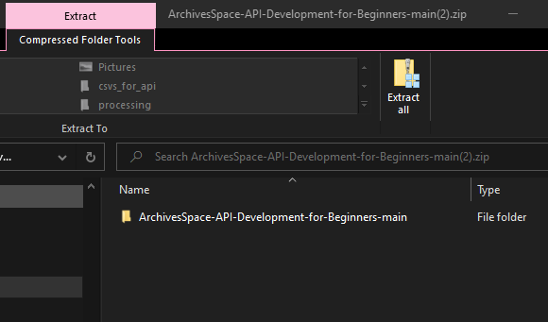
SETTING UP: DOWNLOAD AND UNZIP THE GITHUB FILES
PUT IT SOMEWHERE YOU CAN FIND IT AGAIN

Slide 36
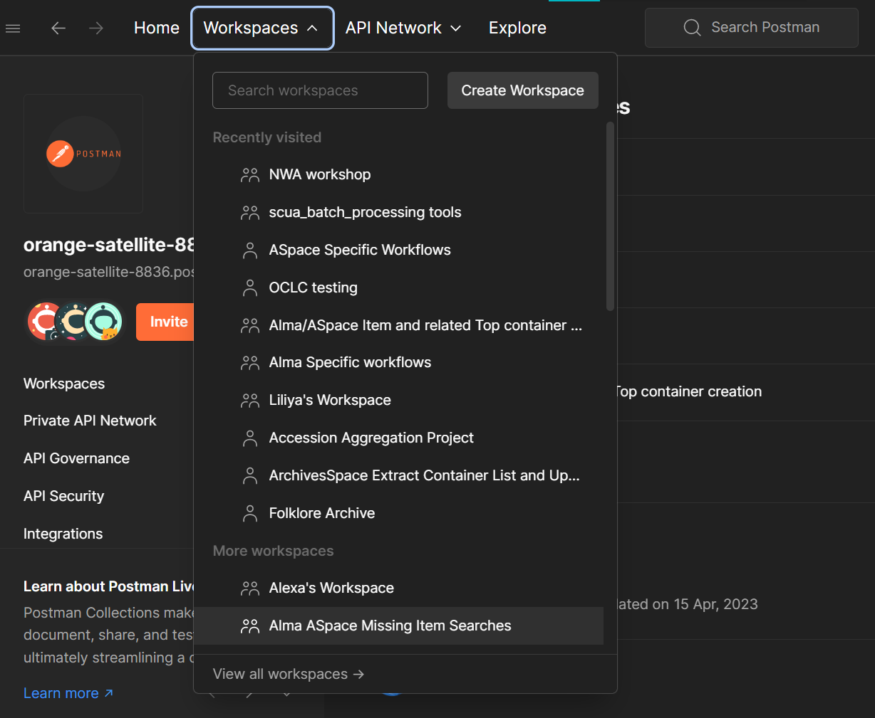
SETTING UP: OPEN POSTMAN AND CREATE A NEW WORKSPACE

Slide 37
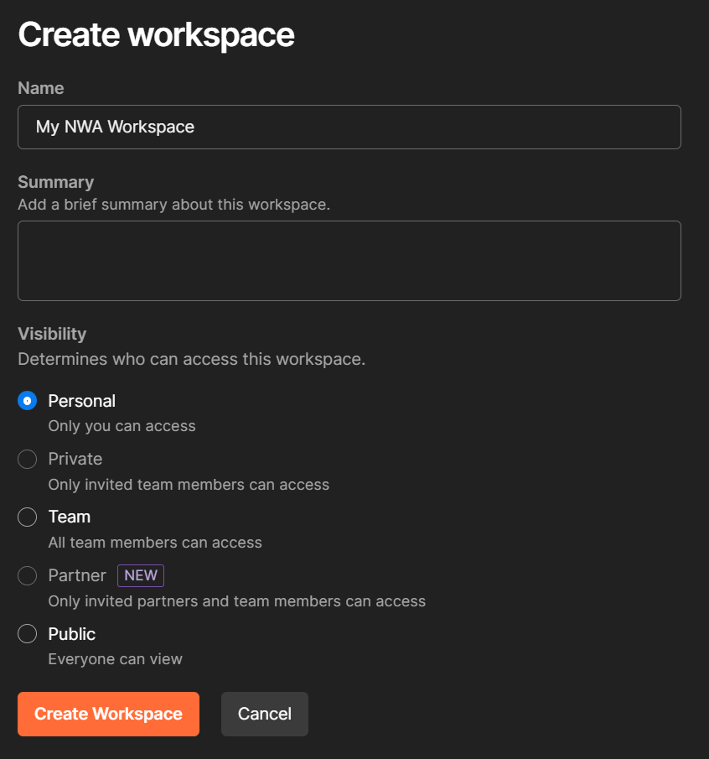
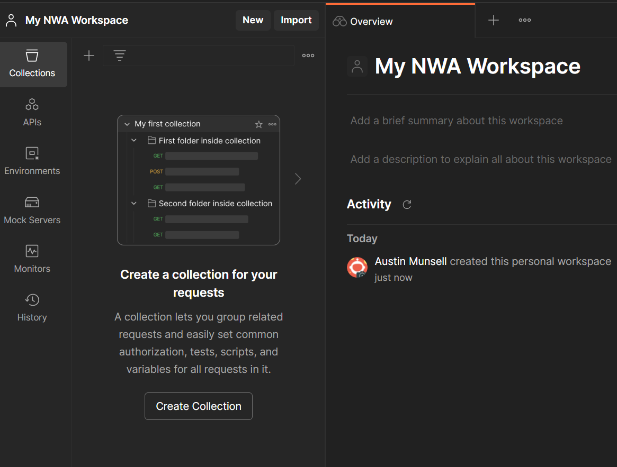
SETTING UP: OPEN POSTMAN AND CREATE A NEW WORKSPACE

Slide 38
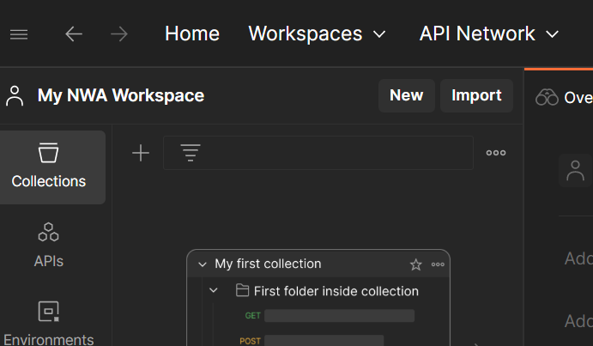
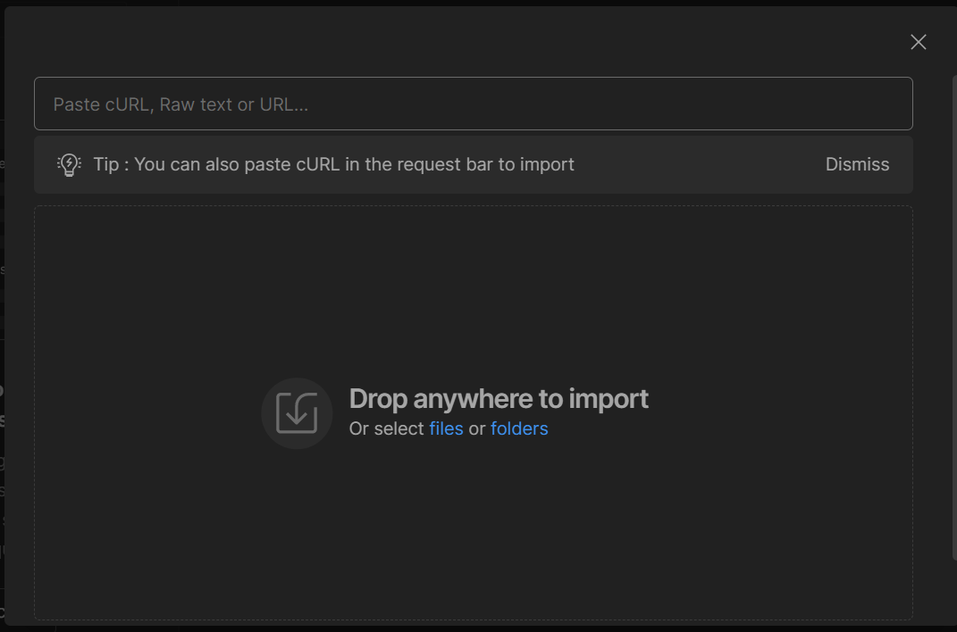
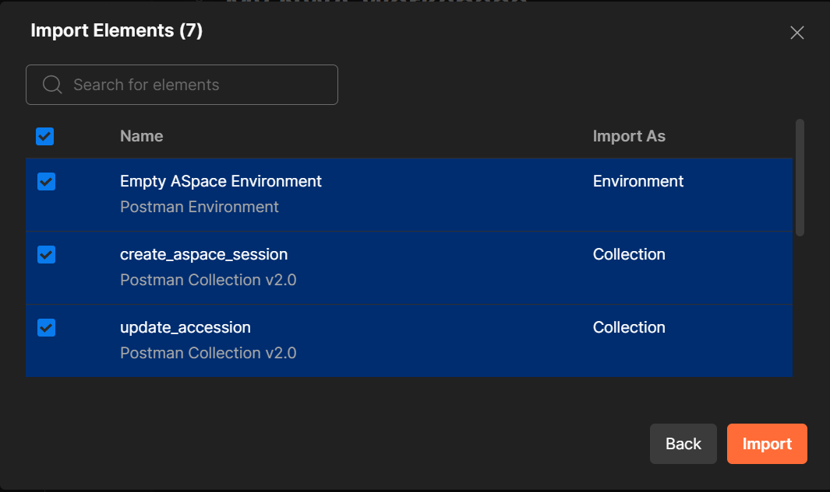
SETTING UP: IMPORT THE FILES INTO POSTMAN

Slide 39
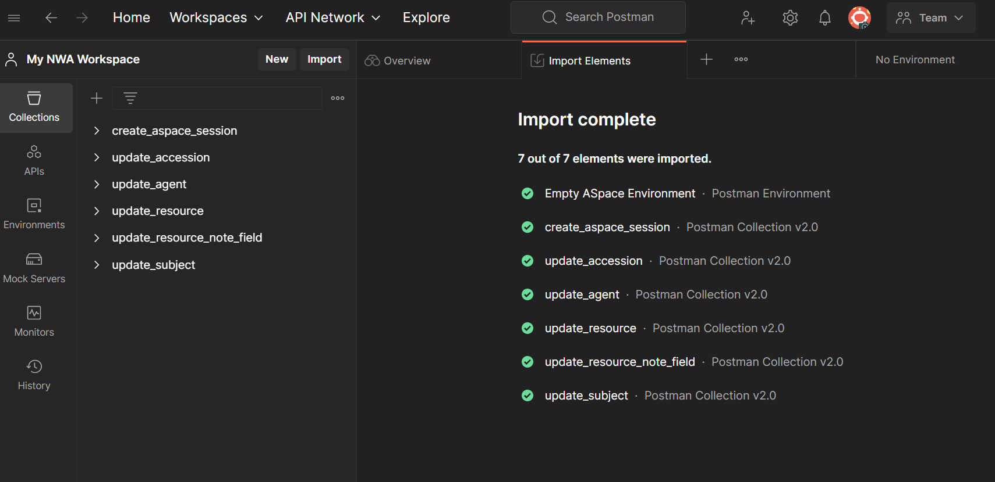
SETTING UP: IMPORT THE FILES INTO POSTMAN

Slide 40
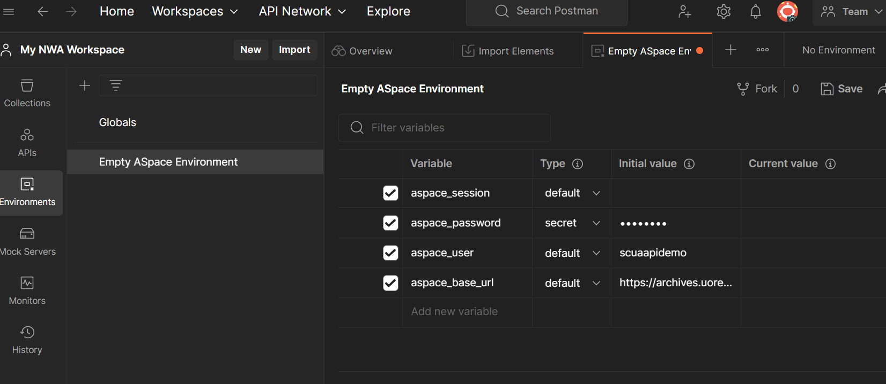
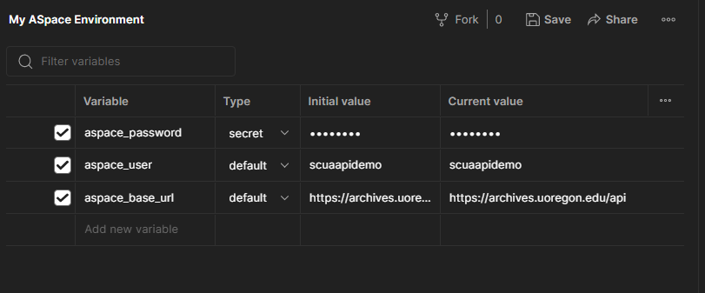
SETTING UP: ADD CREDENTIALS TO THE ENVIRONMENT
UPDATE THE CURRENT VALUE COLUMN

Slide 41
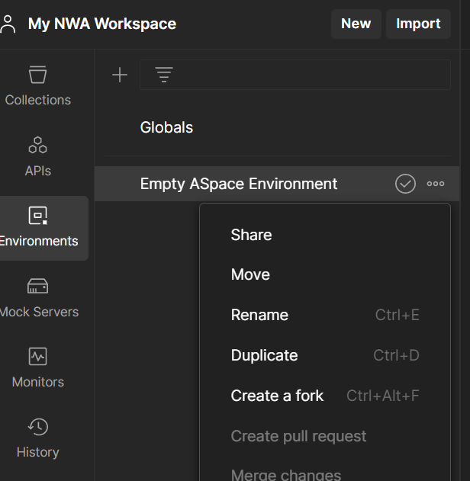
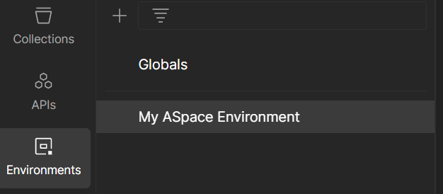
SETTING UP: RENAME THE ENVIRONMENT

Slide 42
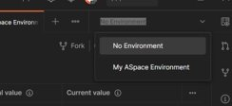
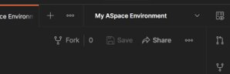
SETTING UP: MAKE YOUR ENVIRONMENT ACTIVE

Slide 43
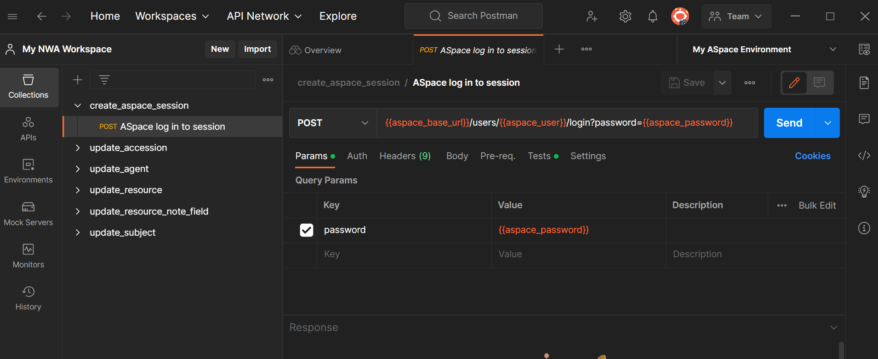
SETTING UP: RUN ASPACE LOG IN TO SESSION TO SET YOUR SESSION

Slide 44
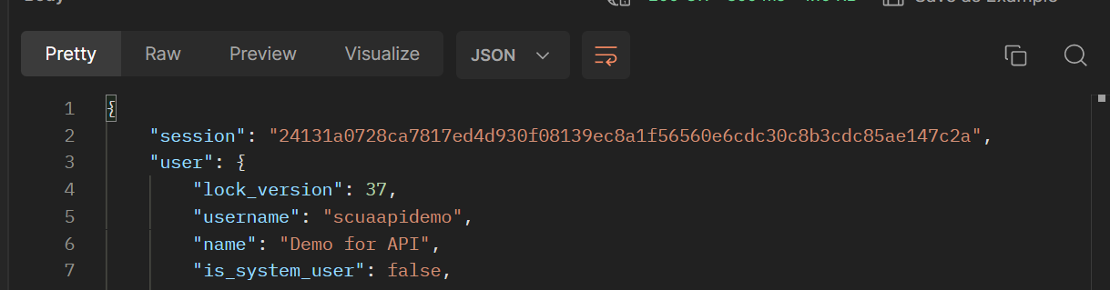
SETTING UP: RUN ASPACE LOG IN TO SESSION TO SET YOUR SESSION
A GOOD RESPONSE RETURNS A "SESSION" THAT LOOKS LIKE THIS:
Notes:
The session id is an encrypted, unique string that identifies the specific session instance. In the session based authentication, the server will create a session for the user after the user logs in. The session id is then stored on a cookie on the user’s browser. While the user stays logged in, the cookie would be sent along with every subsequent request. The server can then compare the session id stored on the cookie against the session information stored in the memory to verify user’s identity and sends response with the corresponding state!

Slide 45
PART 2: UPDATING A SINGLE RESOURCE

Slide 46
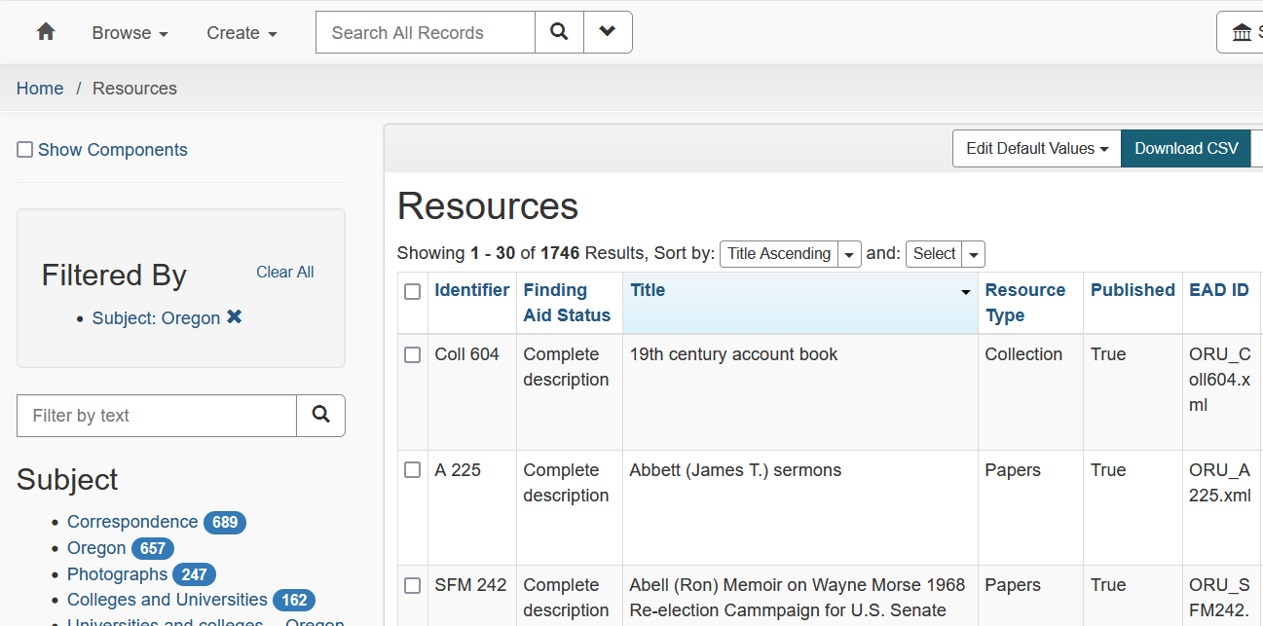
EDITING RESOURCES 1: EXPORT A CSV FROM ASPACE RESOURCE BROWSE

Slide 47
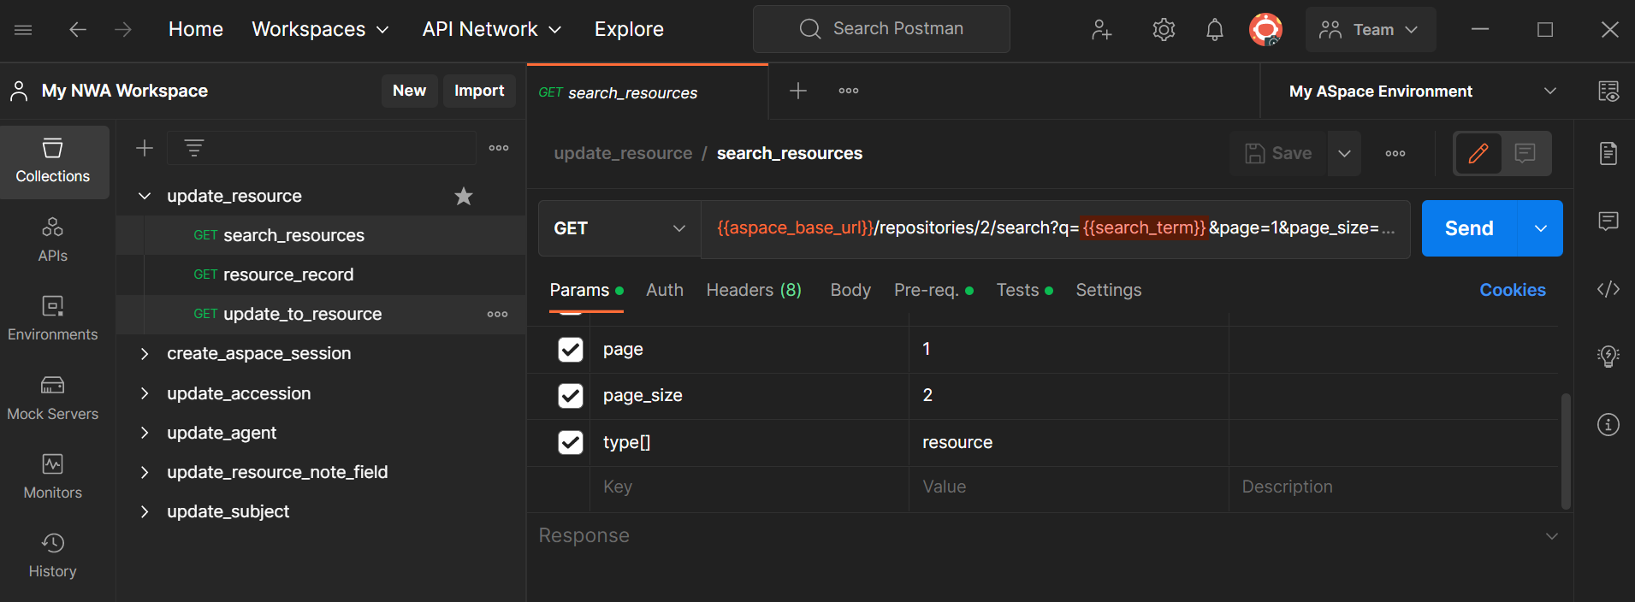
EDITING RESOURCES 1: OPEN SEARCH_RESOURCES IN UPDATE_RESOURCE

Slide 48
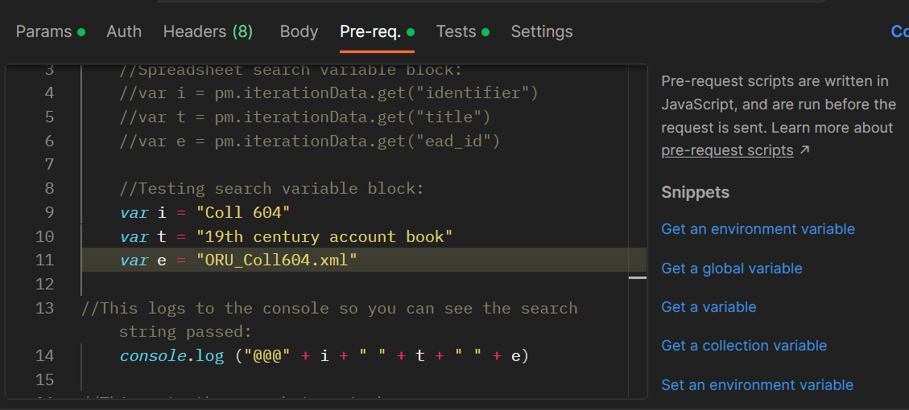
EDITING RESOURCES 1: SET A TESTING VARIABLES IN THE PRE-REQUEST

Slide 49
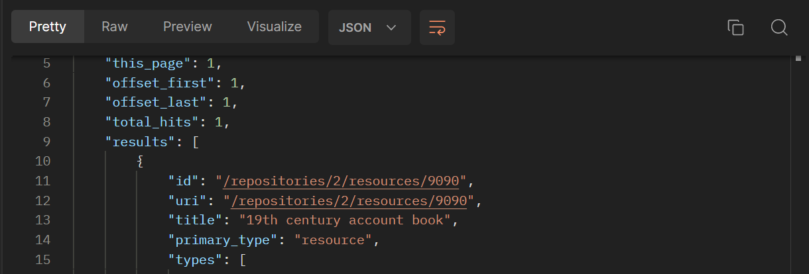
EDITING RESOURCES 1: RUN GET SEARCH_RESOURCES
A GOOD RESPONSE SHOULD SHOW THE TITLE FROM YOUR SEARCH SOMEWHERE NEAR THE TOP OF THE RESULT:

Slide 50
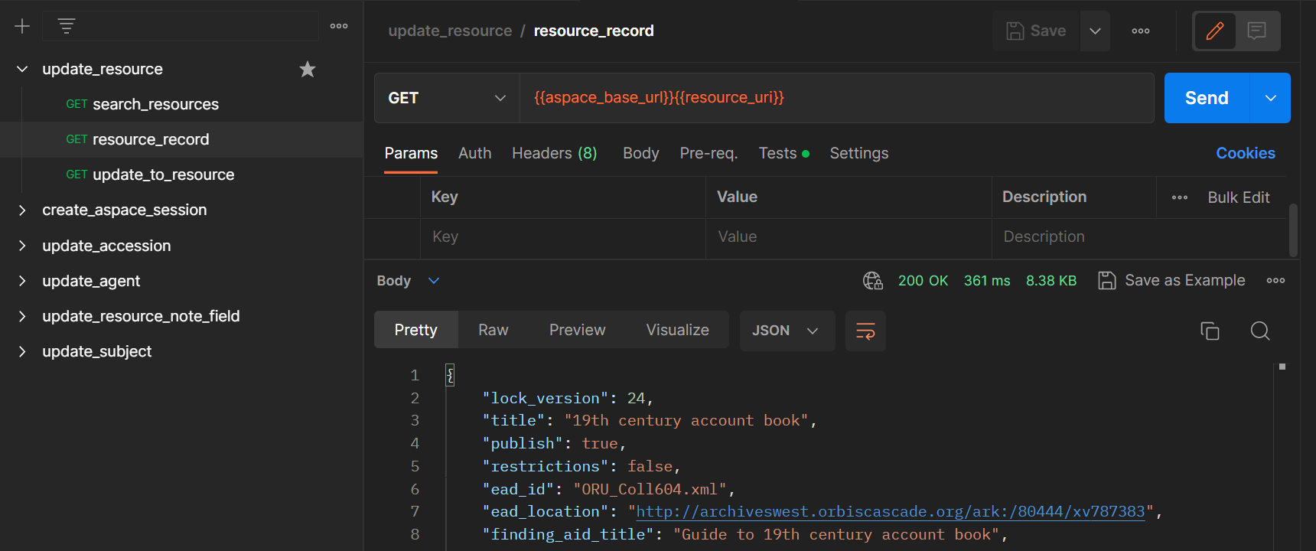
EDITING RESOURCES 1: RUN GET RESOURCE RECORD
A GOOD RESPONSE IS THE RESOURCE RECORD AS JSON:

Slide 51
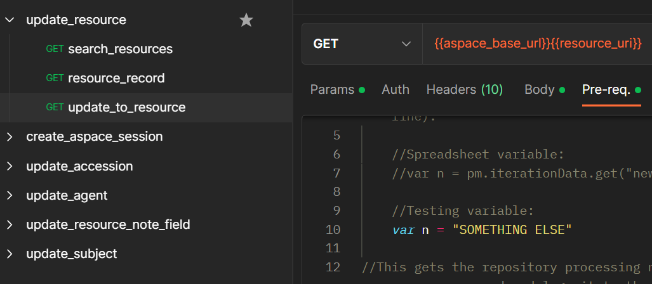
EDITING RESOURCES 1: OPEN GET UPDATE_TO_RESOURCE; CHECK PRE-REQUEST
var n = the thing that will be appended

Slide 52
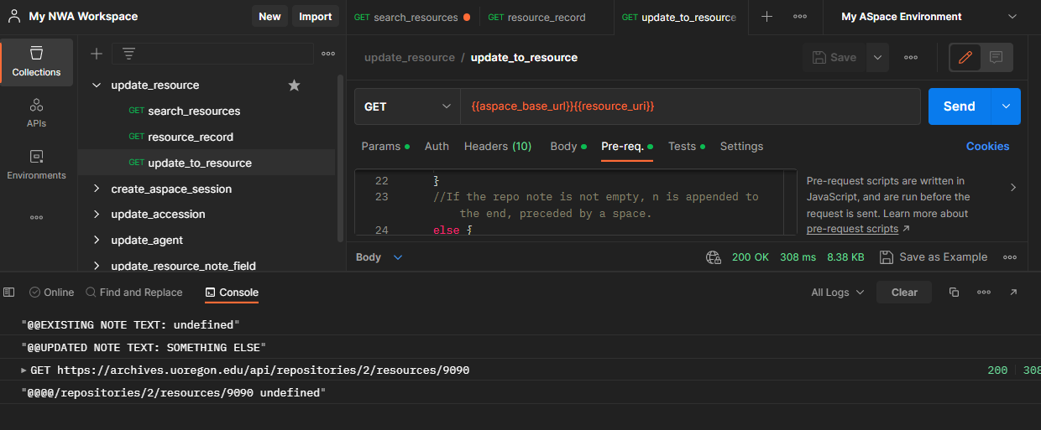
EDITING RESOURCES 1: RUN GET UPDATE_TO_RESOURCE AND CHECK CONSOLE

Slide 53
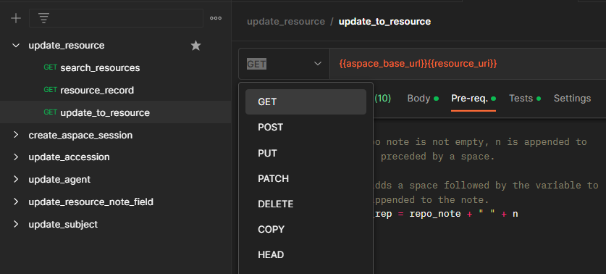

EDITING RESOURCES 1: CHANGE GET TO POST IN UPDATE_TO_RESOURCE
DON'T FORGET TO SAVE

Slide 54

EDITING RESOURCES 1: RUN POST UPDATE_TO_RESOURCE
A GOOD RESPONSE IS 200 OK AND STATUS: "UPDATED"

Slide 55

EDITING RESOURCES 1: CHECK ASPACE TO REVIEW YOUR RESULT

Slide 56
PART 3: UPDATING A BATCH OF RESOURCES

Slide 57


EDITING RESOURCES 2: ADD A NEW COLUMN TO YOUR CSV

Slide 58


EDITING RESOURCES 2: COMMENT OUT TEST VARIABLES AND UNCOMMENT OTHERS

Slide 59


EDITING RESOURCES 2: CHECK COLUMN HEADERS AND VARIABLES
pm.iterationData.get GETS COLUMNS FROM YOUR CSV BY COLUMN HEADING

Slide 60

EDITING RESOURCES 2: CHANGE ALL REQUESTS TO GET AND SAVE FOR TEST RUN
IN POSTMAN, A LITTLE ORANGE CIRCLE MEANS NOT SAVED

Slide 61

EDITING RESOURCES 2: OPEN THE RUNNER

Slide 62


EDITING RESOURCES 2: DRAG AND DROP THE COLLECTION INTO THE RUNNER

Slide 63


EDITING RESOURCES 2: SELECT YOUR CSV AS THE DATA FILE

Slide 64


EDITING RESOURCES 2: PREVIEW YOUR DATA TO MAKE SURE IT LOOKS RIGHT

Slide 65

EDITING RESOURCES 2: MAKE 1 TEST RUN BY CHANGING ITERATIONS TO 1
NOTE: FREE ACCOUNTS MAY HAVE A LIMITED NUMBER OF RUNS PER MONTH

Slide 66

EDITING RESOURCES 2: CHECK THE RUN RESULTS
"STATUS CODE IS 200" IS A GOOD RESULT

Slide 67

EDITING RESOURCES 2: CHECK THE RESULTS IN THE POSTMAN CONSOLE

Slide 68

EDITING RESOURCES 2: CHECK ARCHIVESSPACE TO SEE IF YOUR CHANGE WORKED

Slide 69

EDITING RESOURCES 2: RUN THE FULL SPREADSHEET

Slide 70
THE END
Notes:
Things for Austin to point out at wrap up:
You can copy and reuse/rebuild any of these collections. That is exactly what I do when I am building a new tool. That is also why we created a handful of tools and put them in the Github repository for this session, so folks can take and repurpose them as needed.

